Slide 1

Pathway analysis
Biostat & Bioinfo short course series
2/13/2017
Jianying Li

Slide 2

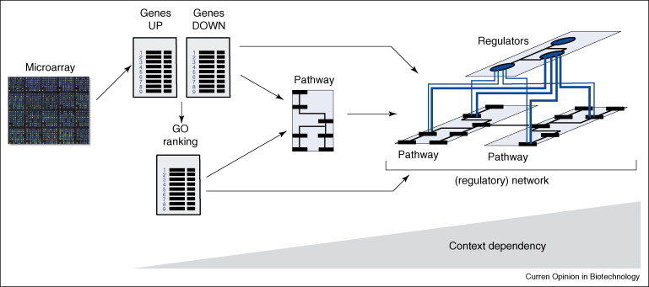
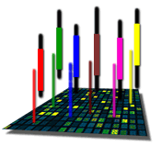
The Road to Pathway Analysis
Next Gen RNA-Seq
Adapted from Werner (2008), Current Opinion in Biotech., 19:50-64
Notes:
2

Slide 3
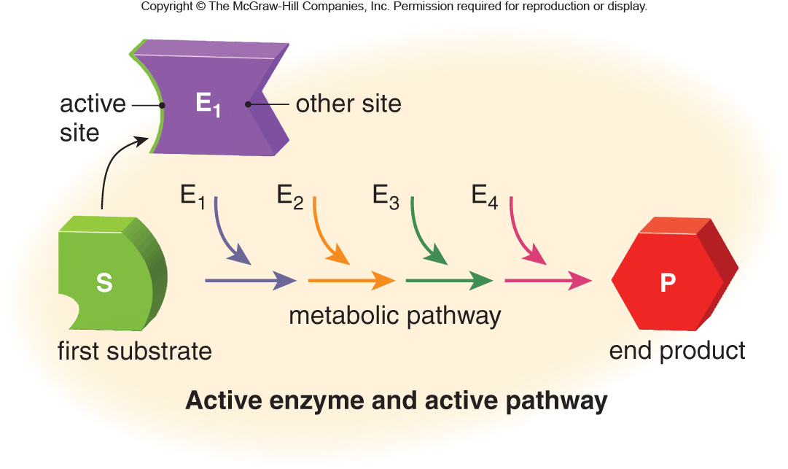
What are biological pathways??
Definition in Wikipedia:
"... a series of actions among molecules in a cell that leads to a certain product or a change in a cell."
Pathway types:
Metabolic pathway
Ontologies
Gene regulation pathways
Signal transduction pathways

Slide 4
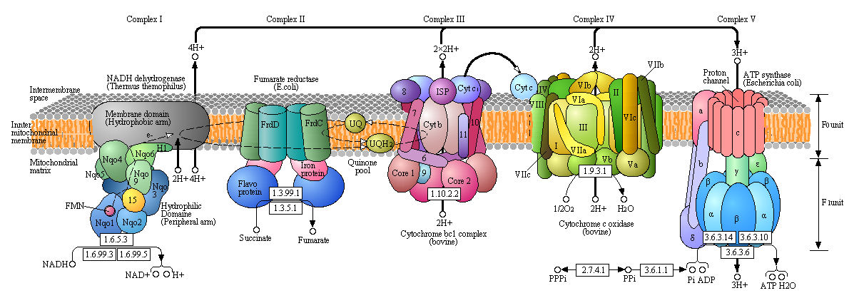
The oxidative phosphorylation
http://employees.csbsju.edu/hjakubowski/classes/ch331/oxphos/olcouplingoxphos.html

Slide 5
Why pathway analysis?
Biological responses are systematic and collaborative
Modern technologies provide high-throughput measurement
Rich knowledge-based accumulation available
Statistical frame works provide the analytical component

Slide 6
Biological responses are systematic and collaborative
Genes are associated and respond collectively toward perturbation or condition changes
Signal obtained from a collection of genes working together reflects a bigger picture
PA offers apparent advantage over single-gene analysis
Different samples from a common condition may have different key genes that are all driving changes in the same pathway
Pathways may be perturbed by subtle changes in many genes
A small list of enriched pathways may be easier to interpret than a large list of associated genes
Pathways results from different studies may overlap better than single-gene results

Slide 7
Modern technologies provide high-throughput measurement
Modern technologies offer large scale (landscape) measurement
MicroArray gene expression
Whole genome exome array
Nano-strings
Next generation sequencing platforms
RNAseq
ChIP-seq

Slide 8
Rich knowledge-based accumulation available
GeneOntology (originated since 1998)
Molecular function describing activities, such as catalytic or binding activities, at the molecular level
Biological process referring to a biological objective to which the gene product contributes
Cellular component referring to the place in the cell (i.e. the location) where a gene product is found
KEGG pathway (originated since 1996)
Metabolism: carbohydrates, energy, lipid, nucleotides, amino acid, xenobiotics
Human diseases
Genetic information processing
Transfac/Transpath
Data on transcription factors, their experimentally-proven binding sites, and regulated genes
Protein-protein interactions and directed modification of proteins involved in signal transduction pathways,
It is a knowledge based/driven approach

Slide 9
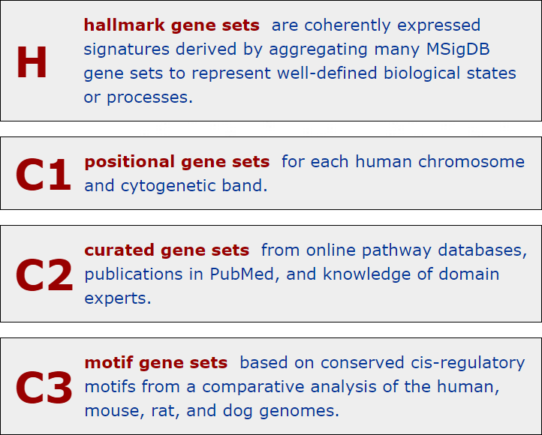
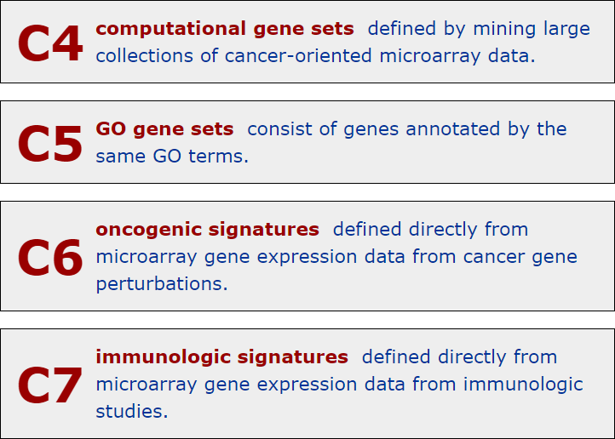
Molecular Signatures Database (MSigDB v5.2)
Free database (http://www.broadinstitute.org/gsea/msigdb)

Slide 10
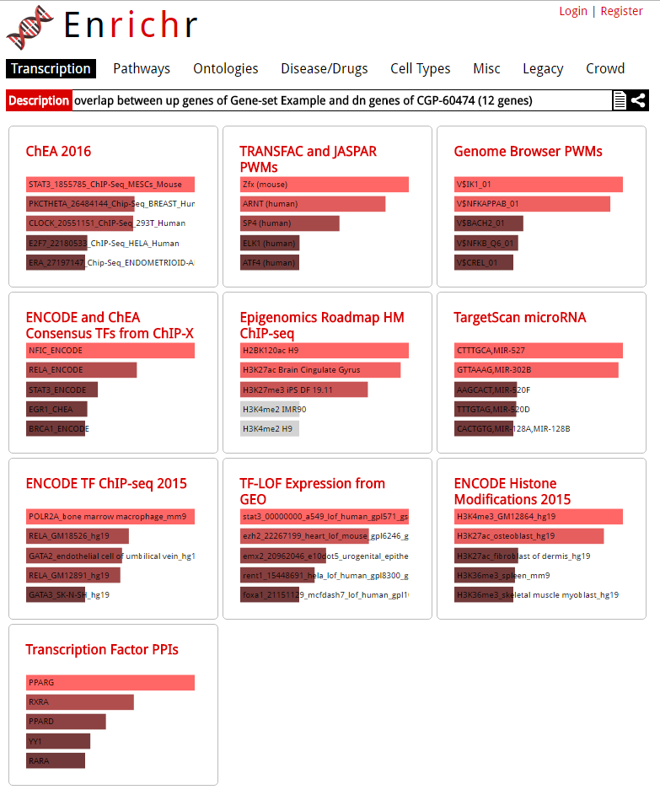
http://amp.pharm.mssm.edu/Enrichr/enrich

Slide 11
Statistical frame works
Well-established statistical and computation algorithms
Parametric method
Hypergeometric test
Fisher’s exact test
Non-parametric approaches
GSEA
GSA
Etc.
Other algorithms
Auto expand : Draws sub-networks around the selected objects
Shortest paths: Uses Dijkstra’s shortest paths algorithm to find the shortest directed paths between the selected objects.
Self regulation :Finds the shortest directed paths containing transcription factors between the selected objects
Etc.

Slide 12
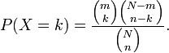
Hypergeometric Test (Right-tailed)
An urn with two types of marbles:
N total # of marbles
Of which, m # of red marbles
Drawing a red marble is a success!
Drawing a white marble is a failure!
n is the # of marbles randomly drawn
k is the # of successes (red marbles) in the sample
Hypergeometric distribution gives the probability
for k = 0,1,2,…,n
k<=m, n-k <=N-m

Slide 13
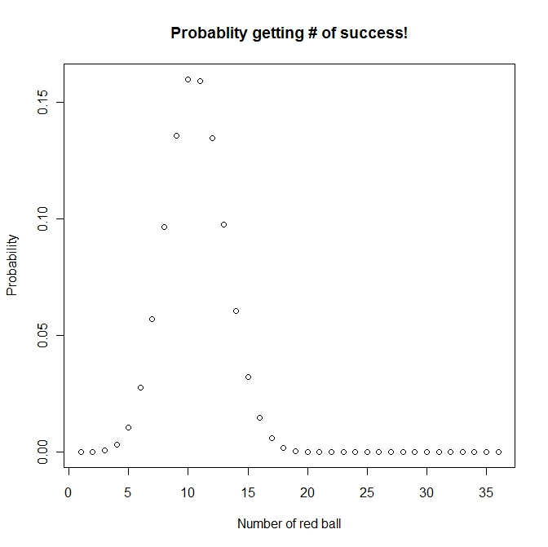
Hypergeometric distribution
m
Number of red ball: 50
Number of white ball: 120
Number of ball drawn (without replacement): 36
Possible number of success ??
(0,1, 2, ….36),
Probability to get 20 red balls is: 0.0001494571
N
n
p(k=20, 36, 50, 170)
http://www.aiaccess.net/English/Glossaries/GlosMod/e_gm_hypergeometric.htm

Slide 14
Pathway analysis (an analogy)
Gene expression analysis results
Total number of gene on a chip: 520
Of which 20 genes are in a GO
Total number of DEG: 40
Of which 5 genes are in GO
total N genes – N, of which m genes belong to a pathway; k genes were identified as differentially expressed, x genes belong to this “pathway”
Do you think it is significant at α=0.01? In other words “is this GO category enriched by/significant this microarray experiment”?
The p-value indicates the probability that the biological process category (particular pathway) is enriched by this microarray experiment by chance. The smaller the p-val, the higher the significance
The answer is simple, which is to perform a hypergeometric test: phyper(4, 20, 500, 40, lower.tail=FALSE) = 0.01371

Slide 15
Fisher’s Exact Test (FET) --right-tailed test
Contingency table
DEG Not DEGs totals
In a GO category x m-x m
Not in GO category k-x n-k+x n
totals k m+n -k m + n (genes on array)
So, now you are probably given something like the following:
x <- 5 #num_of_DEG in GO
m <- 20 #num_of_gene on chip in GO
n <- 500 #num_of_gene on chip NOT in GO
k <- 40 #num_of_DEG
N
Hypergeometric test vs. FET, we shall get same result
phyper((x-1), m, n, k, lower.tail=FALSE)
(fisher.test(matrix(c(x,(k-x), (m-x), (n-k+x)),2,2), alternative='greater'))$p.value

Slide 16
Ingenuity Pathway Analysis (IPA) --Knowledgebase
Desktop Java application utilizing a remote server for data, analysis and file management
IPA Ontology: Curation of the scientific literature and content extraction of the IPA repository of molecular interactions, regulatory events, biological processes, gene-to-phenotype associations, and chemical knowledge

Slide 17
IPA Enrichment Analysis
Uses the Fisher’s exact test to determine the significance of a functional group or pathway
# molecules in a list that are associated with a function/pathway (k)
total # of molecules that are associated with a function/pathway (m)
# of molecules in all possible functions/pathways (N)
# of molecules in a list (n)

Slide 18
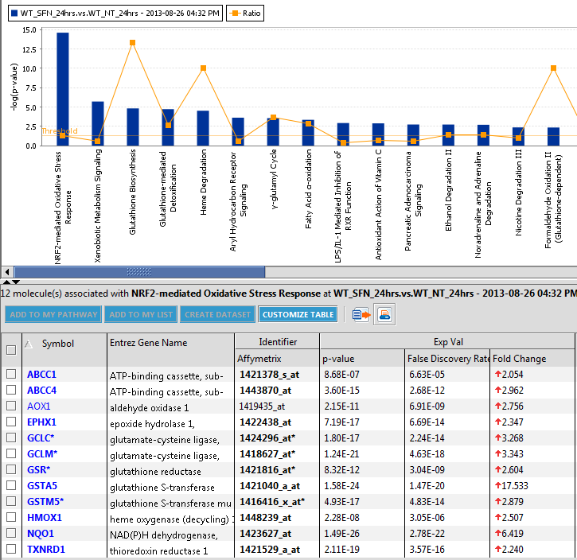
All the DEGs in the pathway are up-regulated
Nrf2-mediated oxidative stress in wild type strain at 24 hours

Slide 19
A non-parametric approach
Based on Kolmogorov-Smirnov (K-S) test
Compare a sample empirical distribution function to the reference distribution
Or, compare two sample empirical distribution functions
Required data:
Ranked list of genes sorted by differential expression (includes all genes)
A gene set
If the genes in the gene set tend to fall near either end of the ranked list, the gene set is considered significantly enriched
The test significance is obtained from empirical distribution
Permutation based
Bootstrapping
Etc.

Slide 20
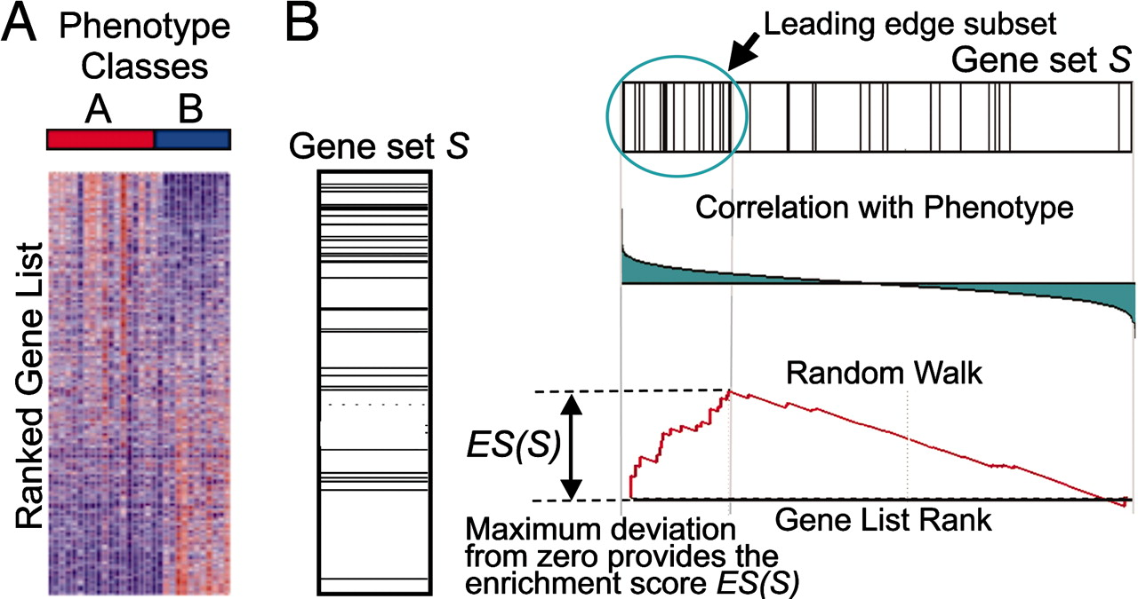
A GSEA overview illustrating the method.
Subramanian A et al. PNAS 2005;102:15545-15550
©2005 by National Academy of Sciences
Notes:
A GSEA overview illustrating the method. (A) An expression data set sorted by correlation with phenotype, the corresponding heat map, and the “gene tags,” i.e., location of genes from a set S within the sorted list. (B) Plot of the running sum for S in the data set, including the location of the maximum enrichment score (ES) and the leading-edge subset.

Slide 21
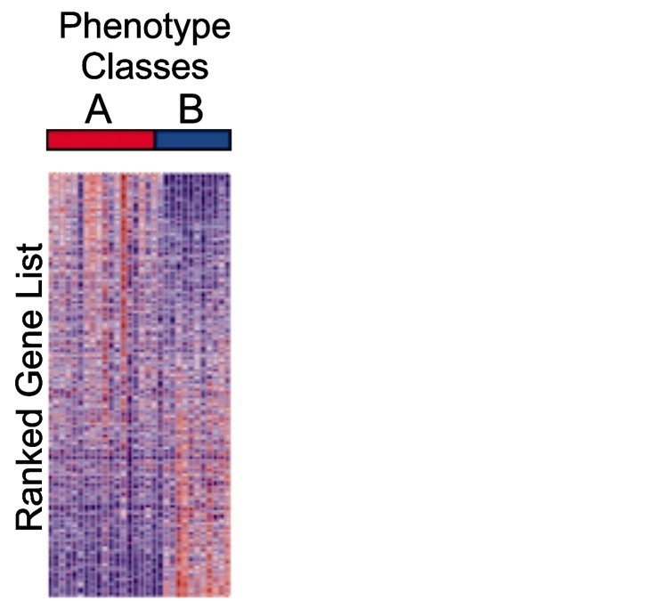
Kolmogorov–Smirnov (KS) Test
(upregulated)
(downregulated)

Slide 22
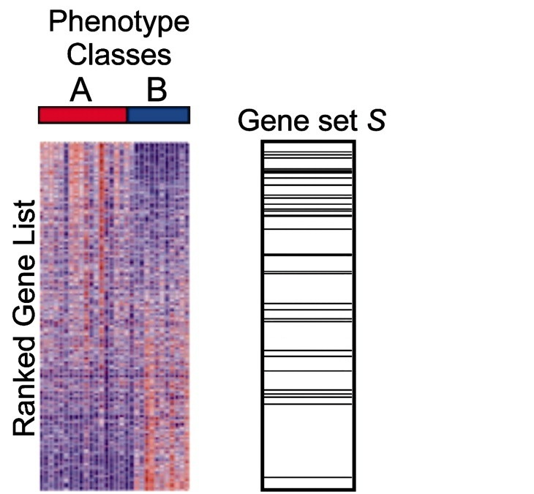
Kolmogorov–Smirnov (KS) Test
(upregulated)
Large, positive enrichment score
(downregulated)

Slide 23
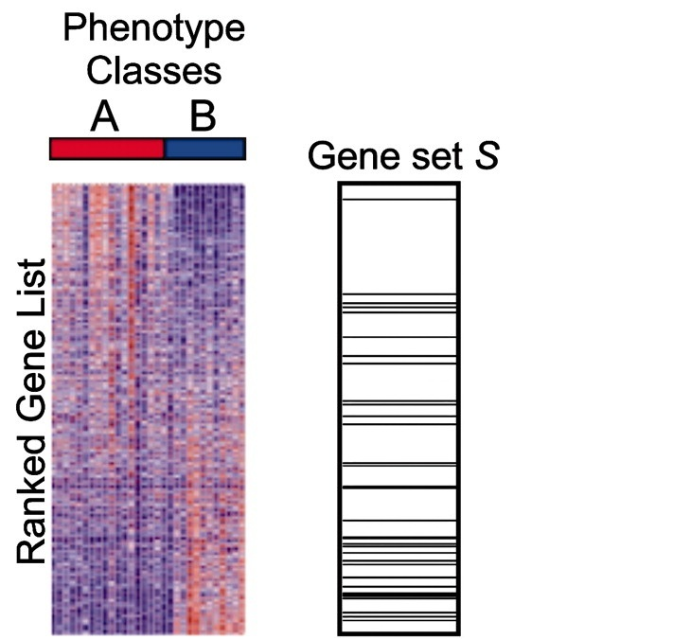
Kolmogorov–Smirnov (KS) Test
(upregulated)
Large, negative enrichment score
(downregulated)

Slide 24
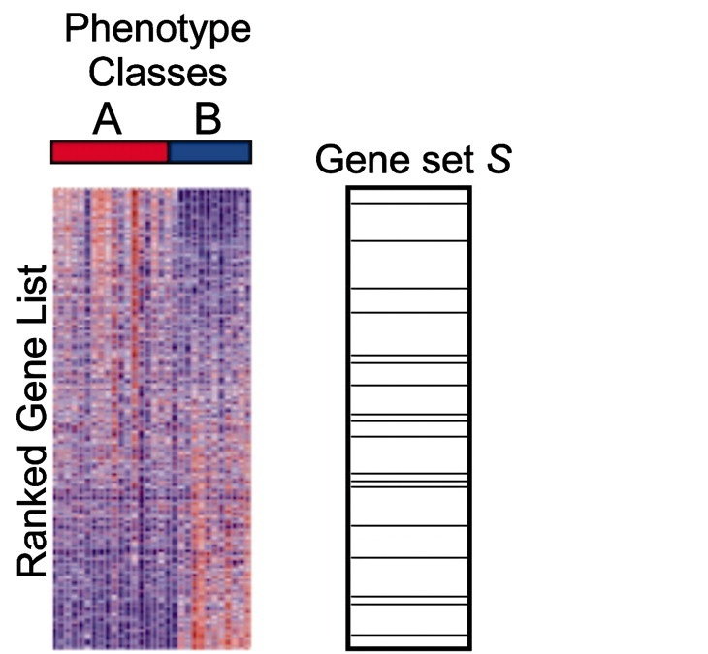
Kolmogorov–Smirnov (KS) Test
(upregulated)
Near zero enrichment score
(downregulated)

Slide 25
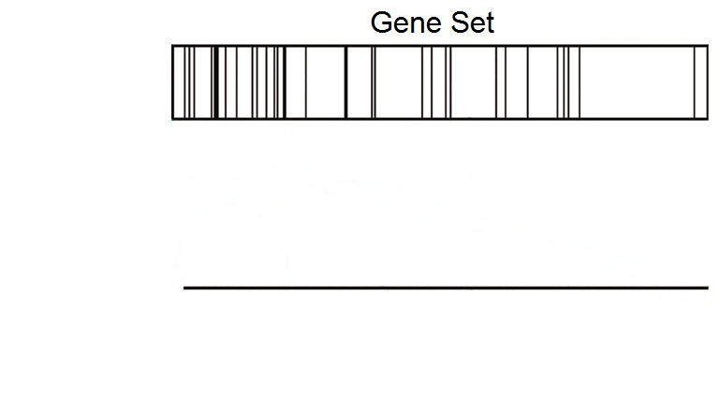
Kolmogorov–Smirnov (KS) Test
(upregulated)
(downregulated)

Slide 26
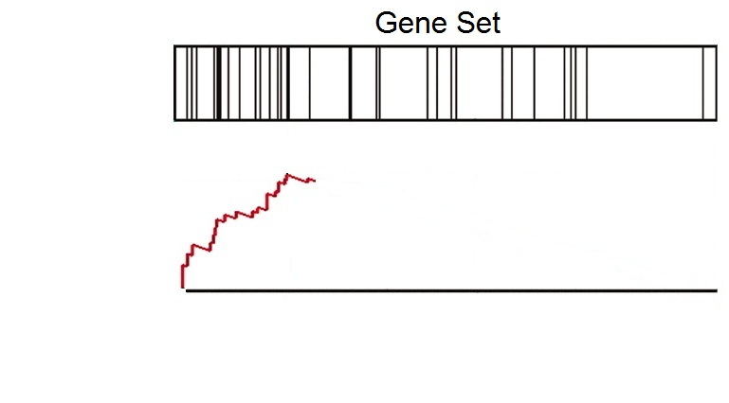
Kolmogorov–Smirnov (KS) Test
(upregulated)
(downregulated)

Slide 27
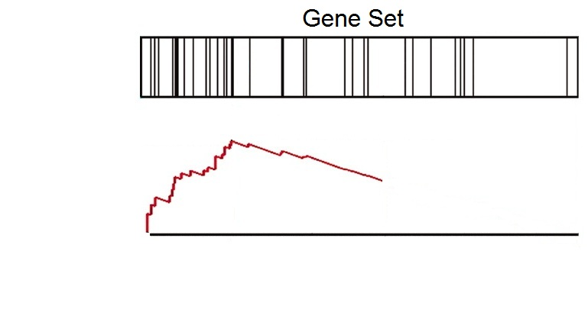
Kolmogorov–Smirnov (KS) Test
(upregulated)
(downregulated)

Slide 28
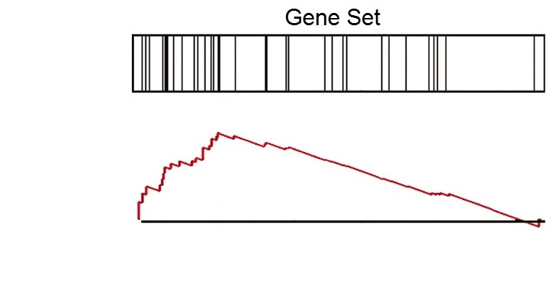
Kolmogorov–Smirnov (KS) Test
(upregulated)
(downregulated)

Slide 29
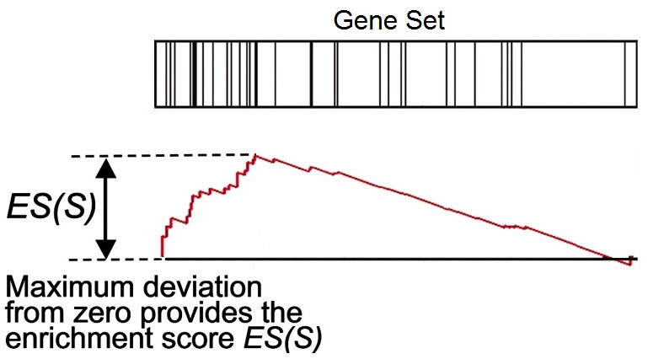
Kolmogorov–Smirnov (KS) Test
(upregulated)
(downregulated)

Slide 30
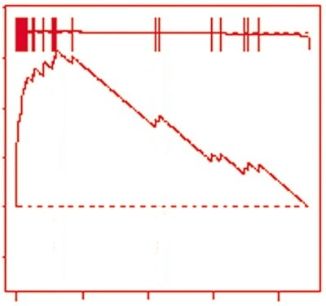
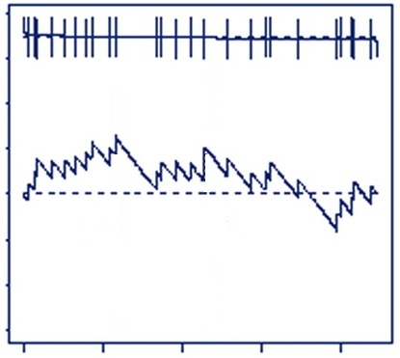
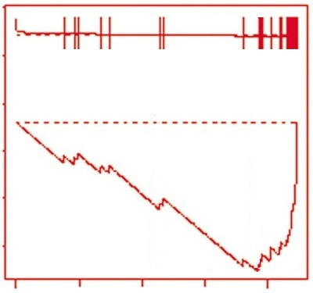
Kolmogorov–Smirnov (KS) Test
Many genes
upregulated
Genes
randomly distributed
Many genes
downregulated
Large positive
enrichment score
Near zero
enrichment score
Large negative
enrichment score

Slide 31
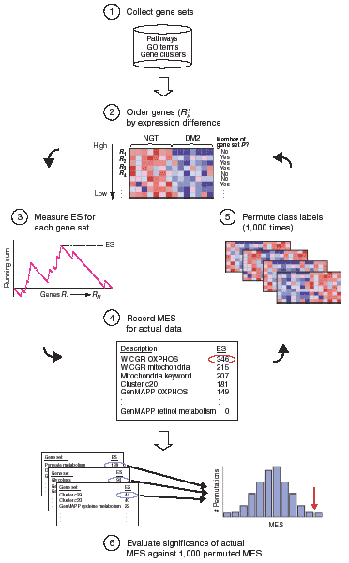
Mootha et al., Nature Genetics, 2003, 34(3):267-273

Slide 32
Additional Processing
Apply a multiple comparison correction (FDR)
Interpret p-values cautiously
Filter out gene sets that are too small or too big
Explore key drivers in significant pathways
Experimentally validate or follow up on significant gene sets

Slide 33
Other Types of Pathway Analysis
Other data types (genotype, copy number, etc.)
Other types of gene lists (genes from proteomics, ChIP targets, etc.)
Custom gene sets (genes of interest, DEGs from another analysis, etc.)

Slide 34
Kolmogorov–Smirnov (KS) Test
Used in Gene Set Enrichment Analysis (GSEA)
Free software (http://www.broadinstitute.org/gsea)
Pros:
Large collection of gene sets
Uses more information than methods that only use DEG list
Enrichment plot improves interpretability
Cons:
Permutation-based p-values

Slide 35
Some caveat in pathway analysis
Concerns with GO based pathway analysis
Ignore GO hierarchy – treat each term independently
Ignore gene (expression) level/rank
Ignore correlation – assuming genes (in a category) are uncorrelated
Sampling over genes (observation)
All these make p values quite unclear
Facts on the non-parametric approach
Pros
Relax on “strong assumption”
Customized gene set is allowed
Cons
Computationally intensive
Some concerns on the statistical power

Slide 36
The universe matters
It is important to choose the universe correctly
Case 1: universe is all genes in the genome
 | DEGs | Non-DEGs | Total
In GO | 10 | 30 | 40
Not in GO | 390 | 3570 | 3960
Total | 400 | 3600 | 4000
p=0.049
Case 2: universe is only expressed genes
 | DEGs | Non-DEGs | Total
In GO | 10 | 30 | 40
Not in GO | 390 | 570 | 960
Total | 400 | 600 | 1000
p=0.0048

Slide 37
Sets are overlapped
A
B
Set B is enriched only because of it overlap with set A

Slide 38
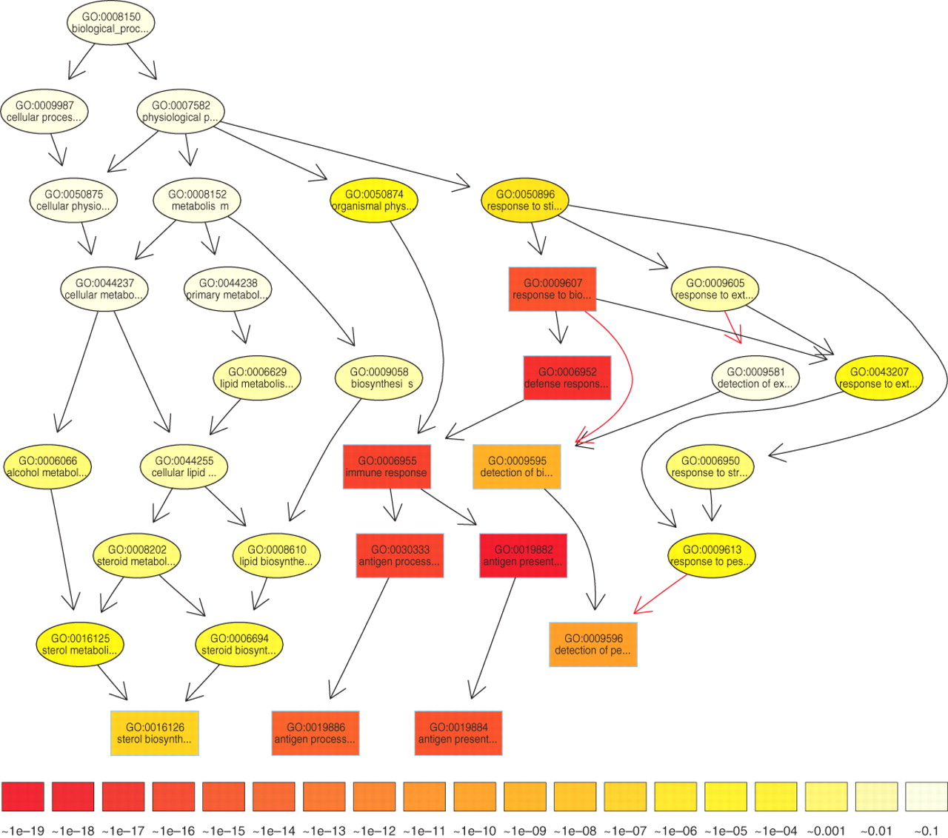

The subgraph induced by the 10 most significant GO terms identified by a current state-of-the-art method for scoring GO terms for enrichment.
TopGO’s elimination algorithm
Test the leaf sets first. If significant,
remove its “genes” before testing its
ancestor sets
TopGO’s weight algorithm
The genes are weighted by their relevance
in the significant nodes.
The enrichment score of a parent (gene
node u) is compared with the scores of
its children.
Children with a better score than u
represent the interesting genes better.
Therefore, their significance is increased
Children with a lower score than u have
their significance reduced.
Alexa A et al. Bioinformatics 2006;22:1600-1607
© The Author 2006. Published by Oxford University Press. All rights reserved. For Permissions, please email: journals.permissions@oxfordjournals.org
Notes:
The subgraph induced by the 10 most significant GO terms identified by a current state-of-the-art method for scoring GO terms for enrichment. Boxes indicate the 10 most significant terms. Box color represents significance, ranging from dark red (most significant) to light yellow (least significant). The numbers in the legend represent the magnitude of the raw p-values associated with the respective color. Black arrows indicate is–a relationships and red arrows part–of relationships.

Slide 39
Now, it is your turn
Hands on practice on both parametric and non-parametric

Slide 40
Click to download

Slide 41
Provide your email

Slide 42

GSEA Example

Slide 43
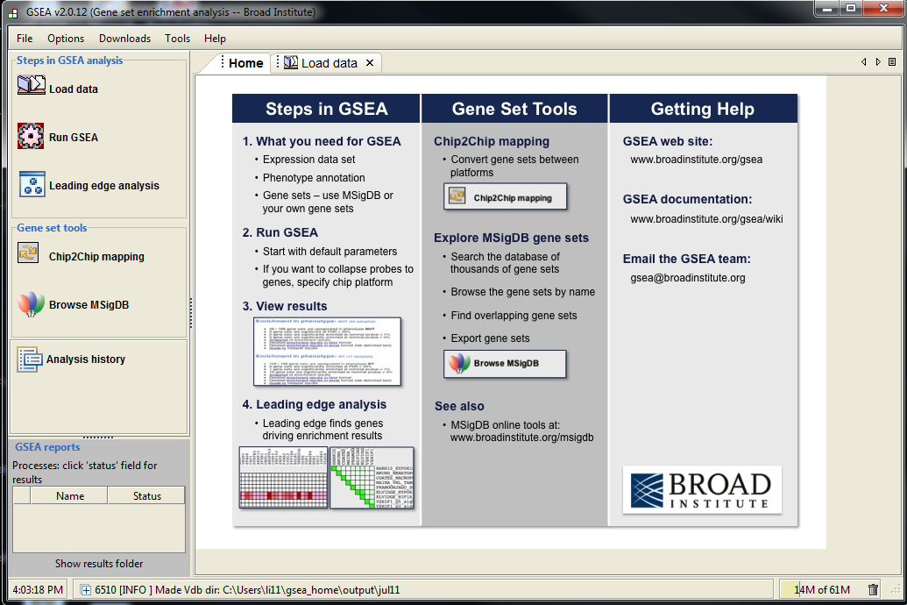
Step 1
Step 2
Step 3

Slide 44
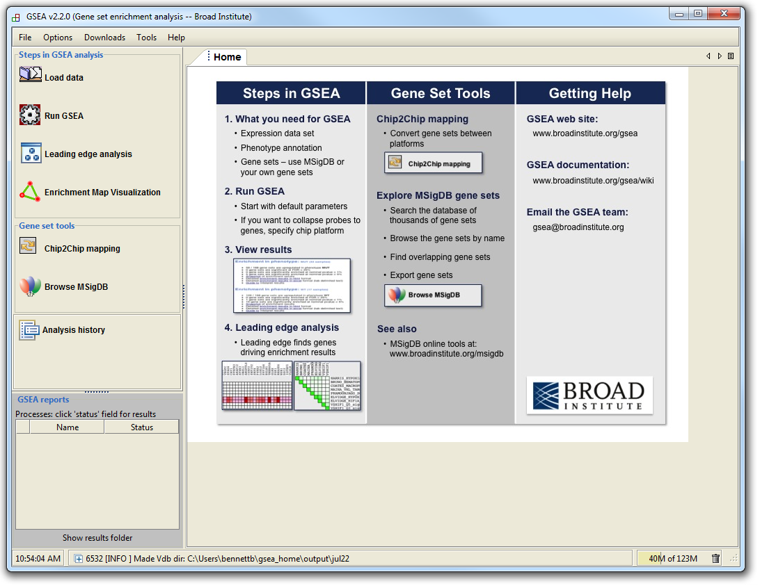
GSEA Example

Slide 45
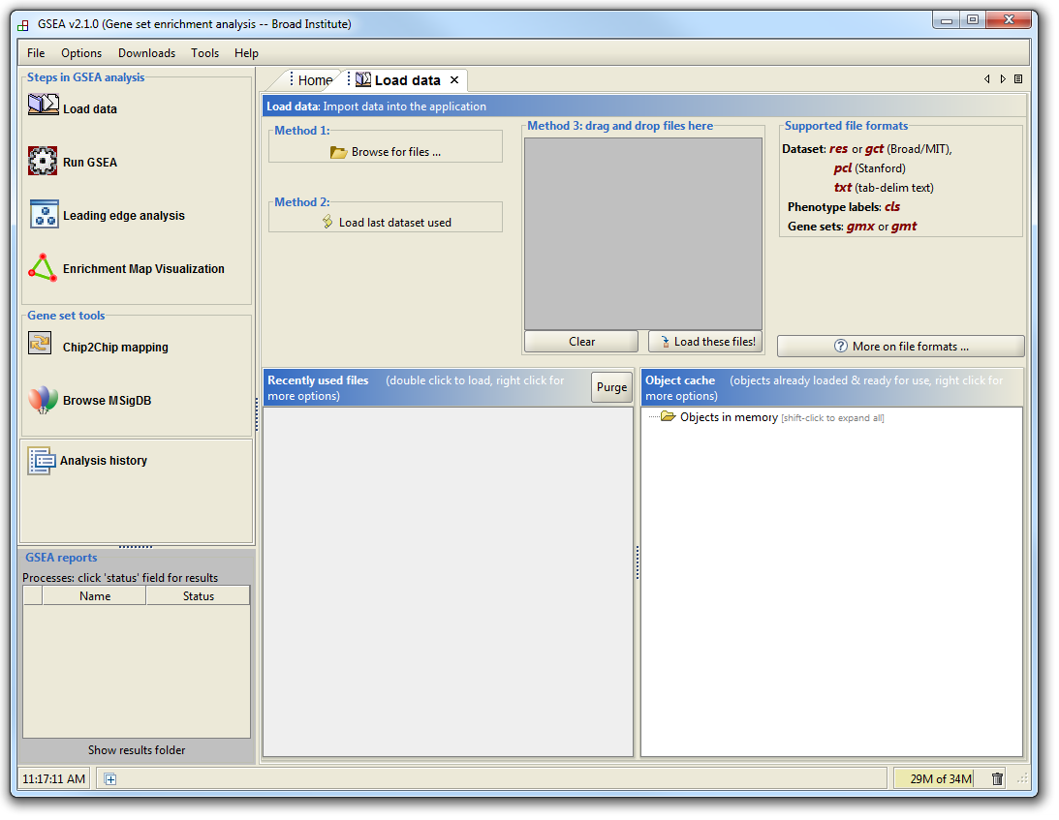
GSEA Example

Slide 46
GSEA Example
Supported file types:
http://www.broadinstitute.org/cancer/software/gsea/wiki/index.php/Data_formats
Required:
Expression data file
Class label file
Optional:
Gene set file

Slide 47
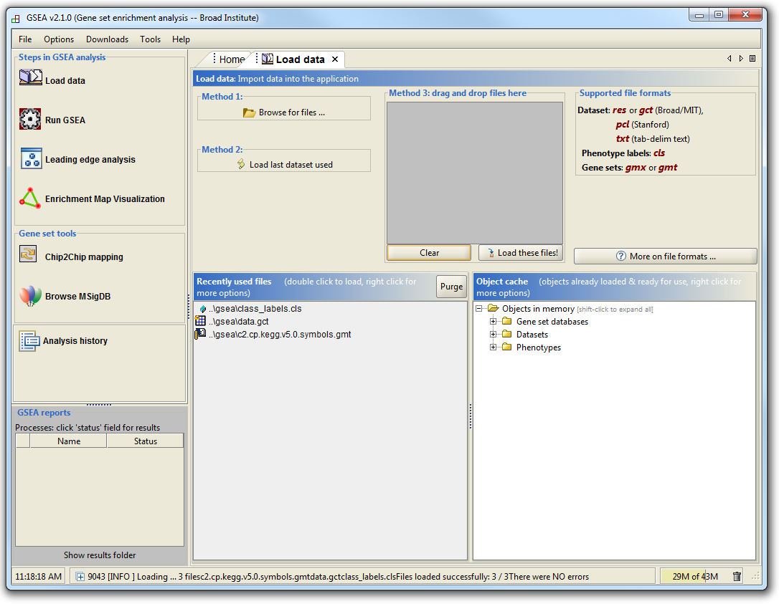
GSEA Example

Slide 48
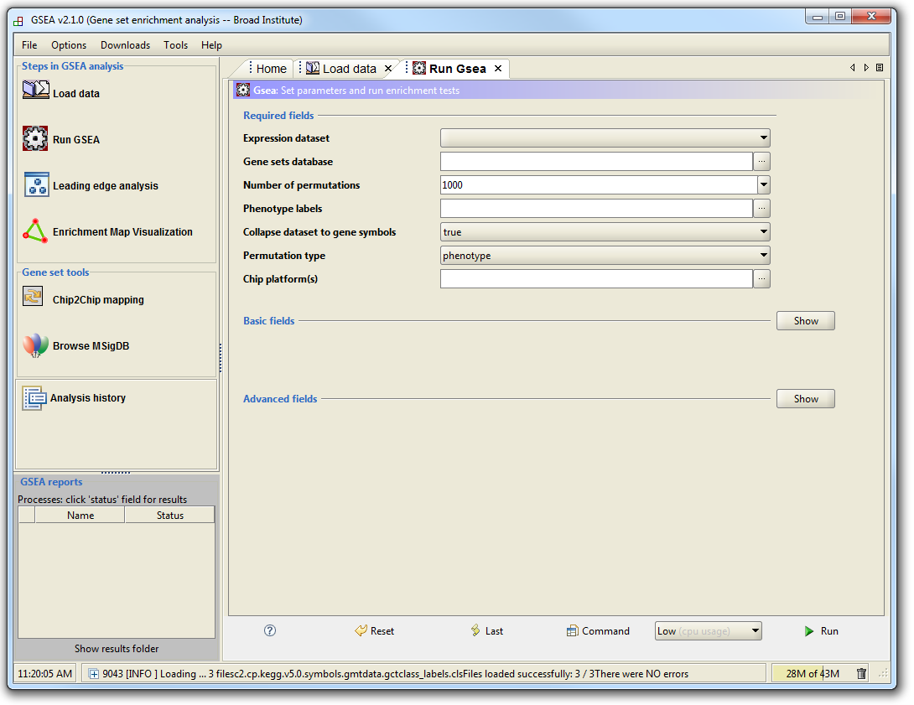
GSEA Example

Slide 49
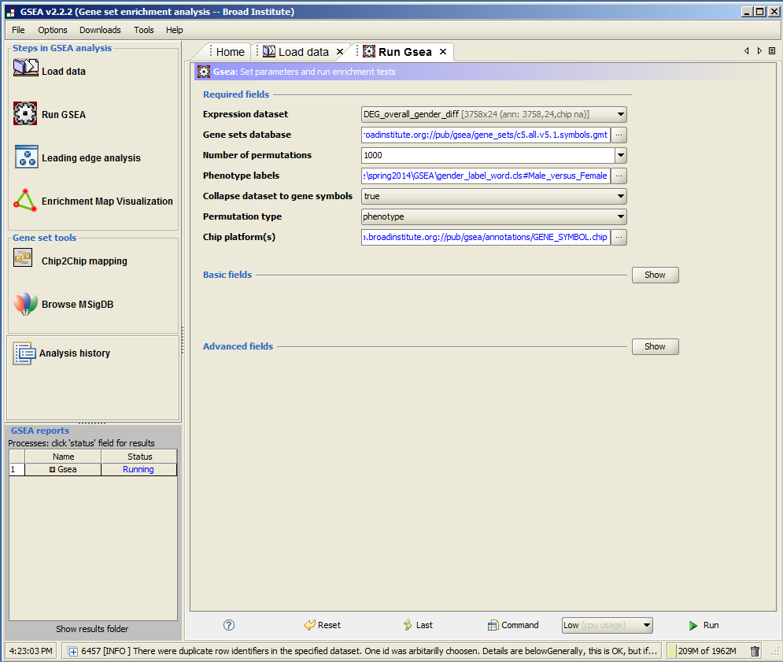

Slide 50
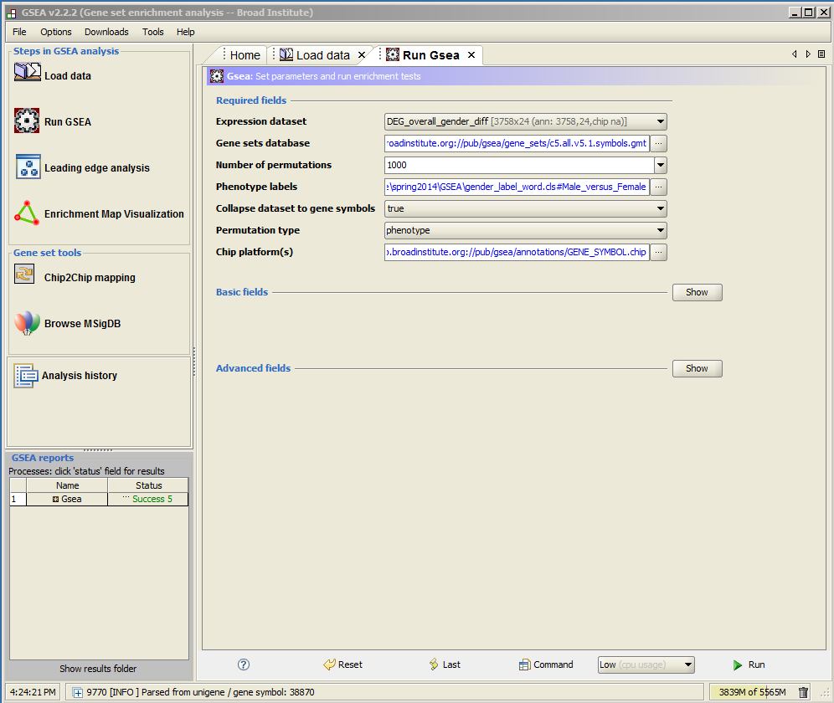
click

Slide 51
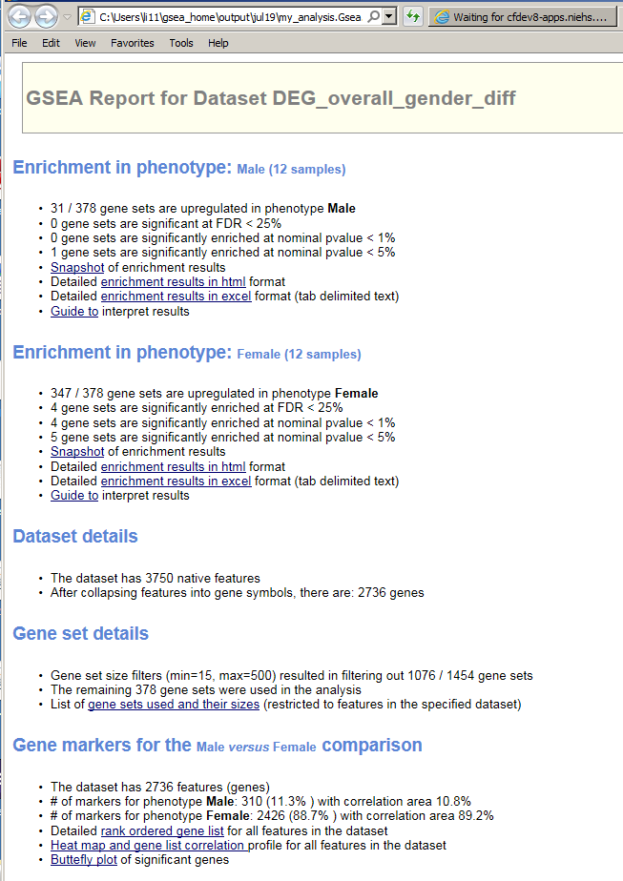

Slide 52
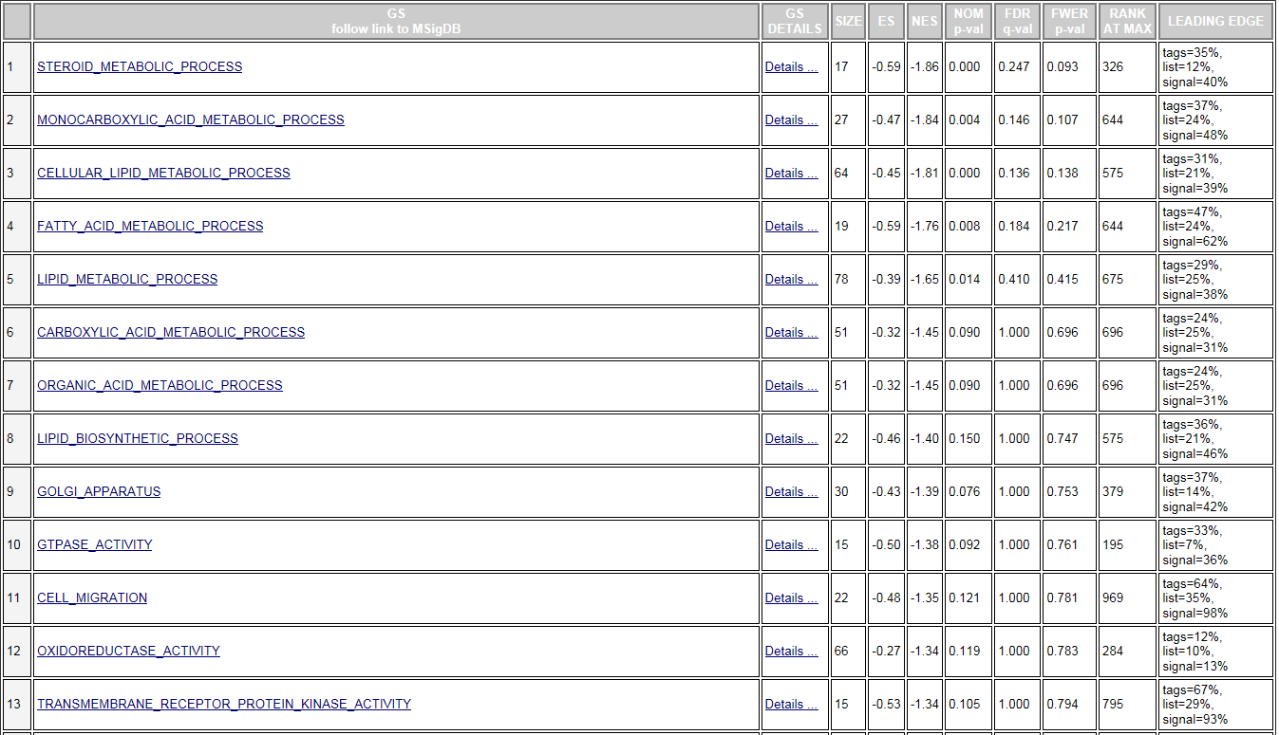

Slide 53
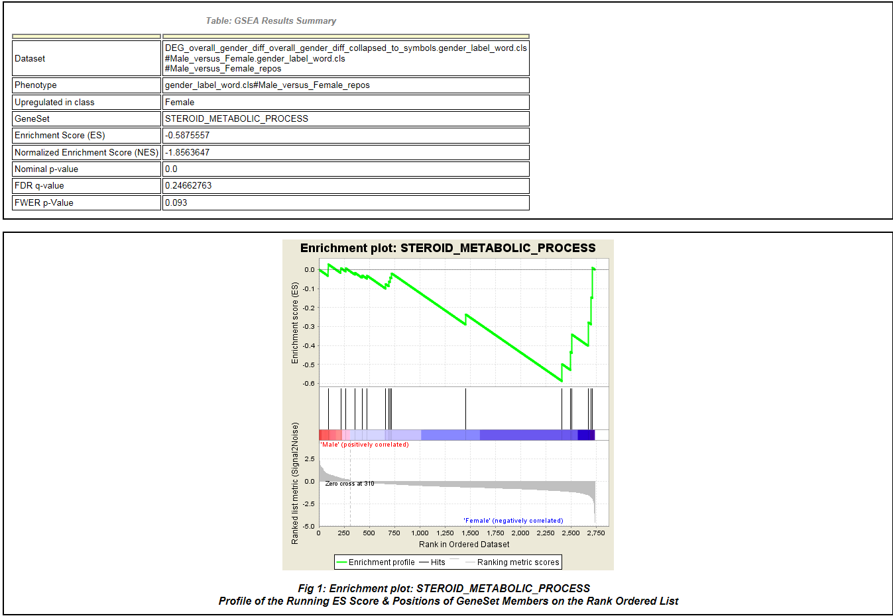
GSEA Example

Slide 54
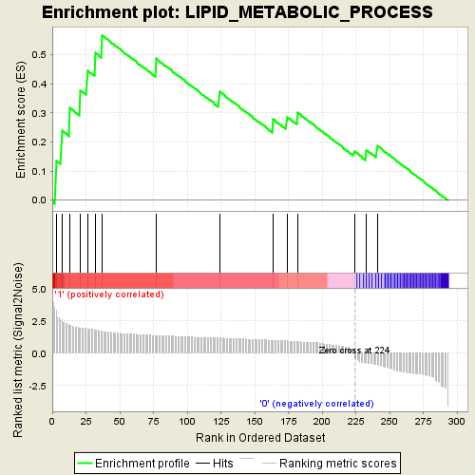
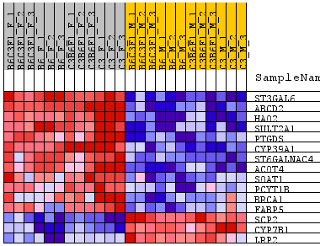
Lipid metabolism enriched -- GSEA

Slide 55
http://www-stat.stanford.edu/~tibs/GSA/
http://www.netsci.org/Resources/Software/Bioinform/pathwayanalysis.html
http://www.broadinstitute.org/gsea/index.jsp
http://david.abcc.ncifcrf.gov/
http://www.biocarta.com/
http://web.expasy.org/pathways/
http://www.genmapp.org/
http://www.genome.jp/kegg/
http://www.ingenuity.com/
http://www.genego.com/metacore.php
http://www.geneontology.org/
http://omicslab.genetics.ac.cn/GOEAST/tutorial.php
http://expressome.kobic.re.kr/GAzer/document.jsp
http://www.biobase-international.com/products
http://jaspar.genereg.net/

